Slide 1



Timba Solutions Kenya
TIMBA SOLUTIONS KENYA
Visit Our Website
www.timbasolutionskenya.info
Your Trusted Market Entry & Business Development Partner in Kenya

Slide 2



PAGE 2 OF 12
Who We Are
We help international businesses establish, operate and grow successfully in Kenya. We bridge the gap between international investors, local opportunities, government institutions, and business partners. With deep local expertise and a professional network across Kenya, we are your trusted partner on the ground.

Slide 3
Why Kenya
Young Workforce
Over 75% of Kenya's population is under 35, providing a dynamic, tech-savvy, and educated talent pool. English is an official language, making communication seamless for international partners.
Strategic Location
Growing Economy
Kenya serves as the gateway to East and Central Africa, with world-class infrastructure including the Port of Mombasa and Jomo Kenyatta International Airport connecting businesses to over 400 million consumers in the region.
Kenya is one of Africa's fastest-growing economies, with a GDP growth rate consistently above 5%. A thriving private sector and expanding middle class create abundant opportunities for international businesses.

Slide 4

PAGE 4 OF 12
Challenges
• Market uncertainty & limited local insight
• Regulatory complexity — registration, permits & licensing
• Finding reliable local partners, distributors & suppliers
• Building a local team & operating smoothly
Our Solutions
• We conduct in-depth market research, opportunity mapping, and develop a tailored entry strategy for Kenya.
• We handle company setup, regulatory compliance, and coordinate directly with government agencies on your behalf.
• We identify, vet, and connect you with trusted Kenyan partners aligned to your sector and goals.
• We support recruitment, onboarding, and day-to-day local operations so you can focus on growth.

Slide 5



PAGE 5 OF 13
Market Entry
Market Research
In-depth market research and tailored entry strategies to position your business for success in Kenya and the wider East African region.
Partner Identification
Identifying and vetting the right local partners, distributors, and dealers to accelerate your market presence and build lasting commercial relationships.

Slide 6

PAGE 6 OF 13
Business Development
Stakeholder Connections
Connecting you with key business stakeholders, industry players, and decision-makers across Kenya to open doors and build strategic relationships.
Growth Support
Ongoing growth-focused support to help you scale operations, expand your network, and capitalise on emerging opportunities in the East African market.

Slide 7


PAGE 6 OF 12
Local Representation & Operations Support
Stakeholder Engagement
We manage relationships with key stakeholders and act as your trusted supplier liaison, ensuring smooth communication between your business and local partners.
Site Visits
We coordinate and conduct professional site visits on your behalf, providing detailed assessments and reports to support your operational decisions in Kenya.
Property & Land Sourcing
We source and secure offices, warehouses, showrooms, and industrial land — managing lease negotiations and support throughout the entire process.

Slide 8


PAGE 7 OF 12
Recruitment & Talent Sourcing
End-to-End Talent Sourcing
We identify, attract, and screen top local talent across Kenya — from entry-level staff to senior professionals — ensuring the right fit for your operations.
Candidate Screening & Vetting
Rigorous background checks, skills assessments, and reference verification to deliver qualified, reliable candidates ready to contribute from day one.
Team Building & Onboarding
We support onboarding, team integration, and workforce planning so your new hires are productive and aligned with your company culture from the start.

Slide 9
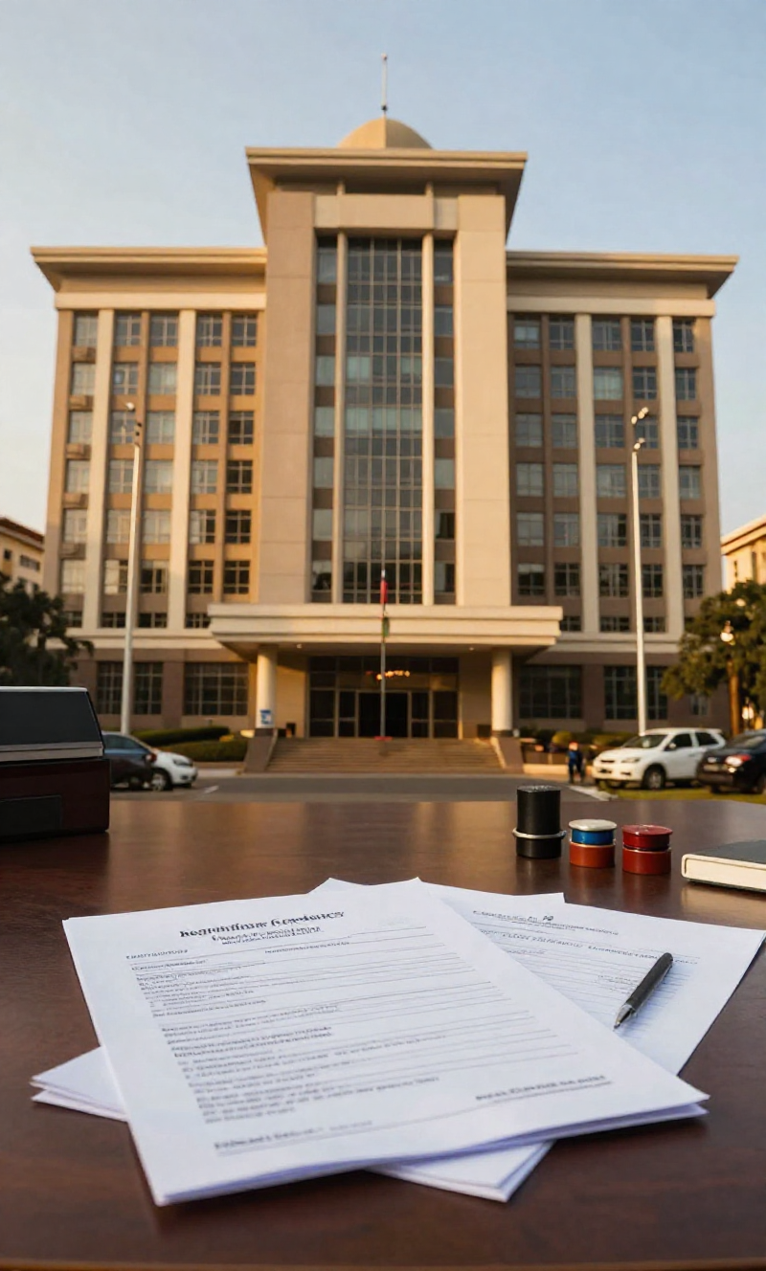
PAGE 8 OF 12
Government Coordination
Company Registration & Licensing
We handle end-to-end company registration, business licensing, and permit acquisition — navigating Kenyan regulatory frameworks so you can operate legally and confidently.
Regulatory Compliance
We ensure your business meets all statutory obligations — from tax compliance and industry regulations to environmental and labour law requirements.
Government Agency Engagement
Direct liaison with government institutions and agencies on your behalf — managing approvals, follow-ups, and official correspondence to keep your projects moving.

Slide 10


PAGE 8 OF 12
Travel & Accommodation
Executive Business Concierge
01
Airport reception, hotel arrangements, and executive transport to ensure a smooth and comfortable arrival and stay.
Supporting every stage of your visit to Kenya. We ensure your executives experience seamless, professional, and productive time in Nairobi and beyond.
Business Itinerary & Meetings
02
Business itinerary planning and meeting scheduling to maximise productivity and ensure every engagement delivers results.
Local Orientation & Support
03
Comprehensive local orientation and on-the-ground support so your executives navigate Kenya with confidence and ease.

Slide 11


PAGE 10 OF 12
Step 1: Initial Consultation
Understand the client's goals, market needs, and entry objectives.
Our 5-Step Process
Step 2: Market Assessment
Research opportunities, risks, and the competitive landscape.
A structured, transparent approach to establishing and growing your business presence in Kenya — from first conversation to long-term success.
Step 3: Strategic Planning
Develop a tailored market entry roadmap, identify partners, and align resources.
Step 4: Local Execution
Handle on-the-ground implementation including representation, registration, sourcing, and operations.
Step 5: Ongoing Support
Provide continuous local representation, stakeholder engagement, performance monitoring, and adaptive strategy for sustained growth in Kenya.

Slide 12



PAGE 11 OF 12
Local Expertise & Representation
Your Local Partner
Why Partner With Us?
Deep local knowledge, professional representation, and established networks across Kenya's key industries and institutions.
We become your local extension. Timba Solutions Kenya bridges the gap between your international ambitions and successful on-the-ground execution — so you never navigate Kenya's market alone.
Reduced Risk & Clear Communication
Lower Your Risk
We minimize market entry risk through proven processes, transparent reporting, and honest guidance at every stage of your journey.
Long-Term Partnership Commitment
Built to Last
We invest in your long-term success in Kenya — from initial entry through sustained growth, operations, and ongoing business development.

Slide 13





Timba Solutions Kenya
Let's Build Together
We are ready to be your trusted local partner in Kenya. Reach out to us and let's start the journey.
+254 715 005 299
www.timbasolutionskenya.info
bensonyada@timbasolutionskenya.info

